Slide 1

Image Classification workshop
By

Slide 2
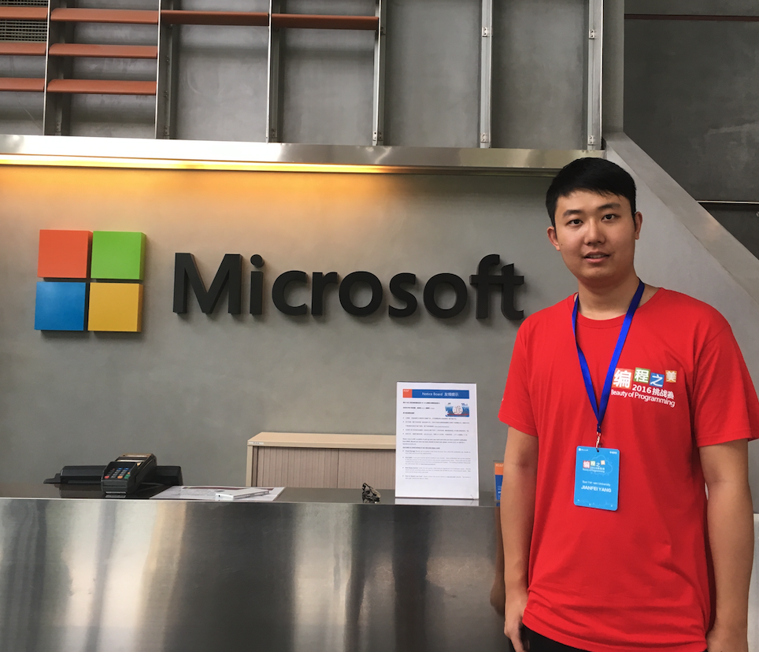
Speaker: Jianfei Yang
Jianfei Yang is currently a 3rd year PhD student at Nanyang Technological University. Now he has published more than 20 international papers in the field of artificial intelligence and internet of things.
He is the champions in several challenging competitions including Microsoft Beauty of Programming 2016, Buildathon in Singapore’s Ministry of Education and JD global data challenge.
He also got first prize in many discipline contests, such as National IOT Design Contest, National Mobile Internet Innovation Contest, Microsoft Imagine Cup in China and American Mathematical Contest in Modeling.
He ever interned as a vision engineer at DJI in 2015 and worked as a visiting scholar at UC Berkeley in 2018.

Slide 3
Let’s Start
1. Image Classification (IC) Concepts & Environment Set-ups
2. Image formatting & processing
3. Model Built-up & Model Training
4. Make predictions with the Model
Outline

Slide 4

Concepts & Environment Set-ups
Make sure that your laptop can run basic Python3 programs. (e.g. Hello World)
If you haven’t installed Python, please proceed to install PyCharm.
https://www.youtube.com/watch?v=cHa85et7LK0
The installation instruction starts from 2:40.

Slide 5
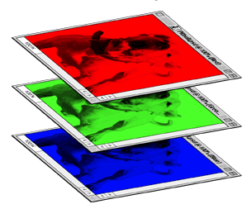
Concepts & Environment Set-ups
How do Computers conduct Image Classification?
When a computer takes an image as input, it will see an array of pixel values. (0-255)
Depending on the resolution and size of the image, it will see a WIDTH x HEIGHT x 3 (RGB) array of numbers. For example, suppose we have a colorful image with a size 480 x 480. The array seen by the computer will be 480 x 480 x 3.
Through a classification model, the computer will then output the probability of the image being a certain class.

Slide 6


Concepts & Environment Set-ups
How is it relevant to Python?
Keras with TensorFlow is a high-level library set in Python to build and train Neural Networks.
1. User friendly 2. Modular and composable 3. Easy to extend
4. Developed by Google – High Quality!
Easy to start with 0 basic knowledges!

Slide 7
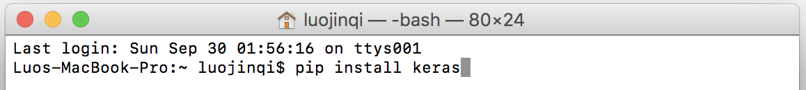
Concepts & Environment Set-ups
The operation is the same in Windows Command Window & MacOS Terminal:
pip install numpy
pip install scipy
pip install tensorflow
pip install keras
pip install pillow
If you use Python3 environment:
pip3 install keras
pip3 install tensorflow
pip3 install pillow

Slide 8
Concepts & Environment Set-ups
Download the zipped pack from link:
That contains all the materials that we need today. (Slides also included)
Run test_environment.py to check whether your libraries have been installed.
Wait a few seconds to see the output.
Ignore the Warning Notes.
If the message “Congrats” is shown, the your environment is ready to go.
Inform the assistants if any bugs happen.

Slide 9
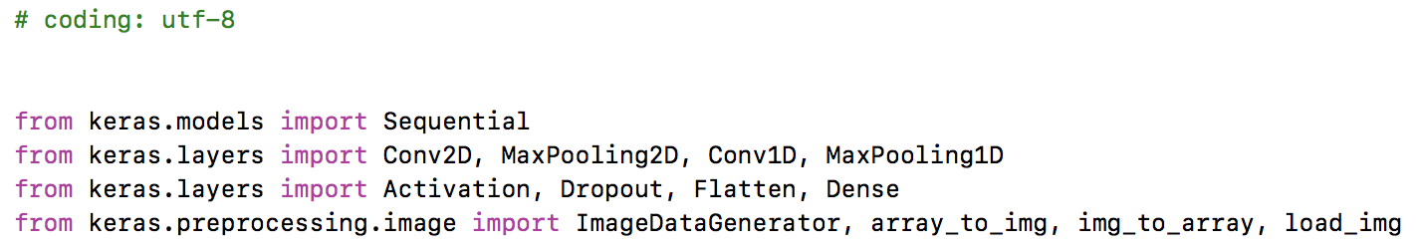
Concepts & Environment Set-ups
Type the following lines of codes to set up your coding environment.
(Or just copy the corresponding part from sample_model.py)
Now you are ready to process the images and train a model.

Slide 10
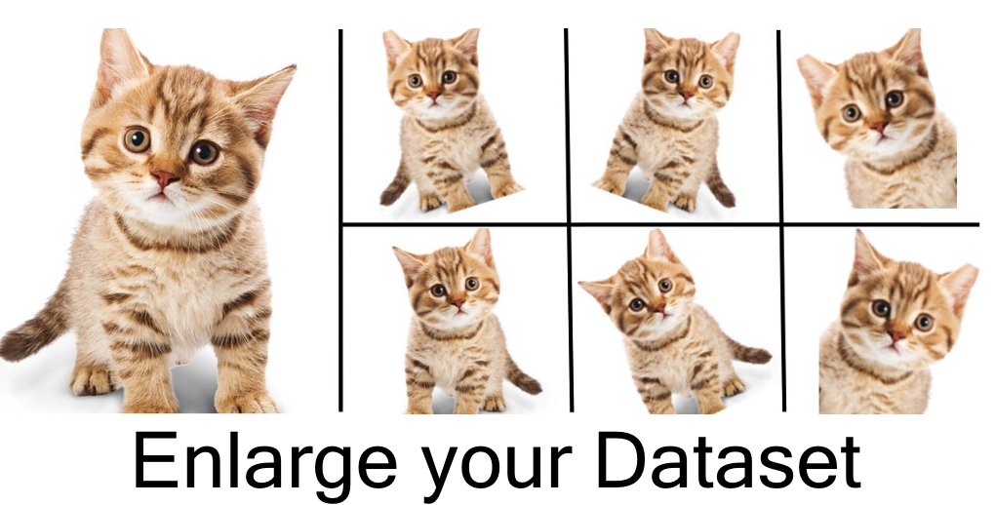
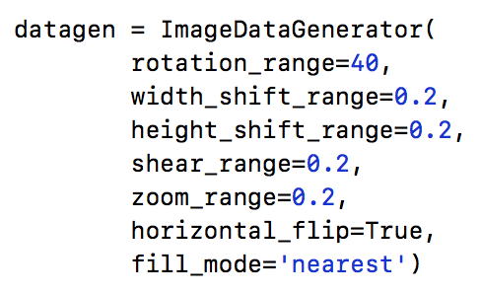
1. Data augmentation
Approaches that increment the training dataset using the existing data.
It allows us to artificially expand our dataset. Some popular augmentations are horizontal flips, random crops, translations, rotations, and so on.

Slide 11
Image formatting & processing
Here we implement a generator from Keras.
(Type or copy the ImageDataGenerator from sample_model.py)
rotation_range: Degree range for random rotations
width_shift_range: Fraction range of total width for shifting.
height_shift_range: Fraction range of total height for shifting.
share_range
zoom_range: Fraction range for random zoom.
horizontal_flip: Randomly flip inputs horizontally.
fill_mode
If you cannot remember so much terms, don’t worry as this not the key things in IC.

Slide 12
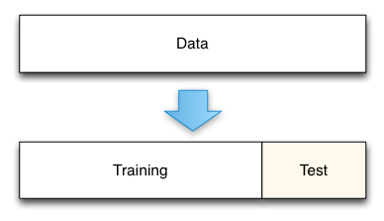
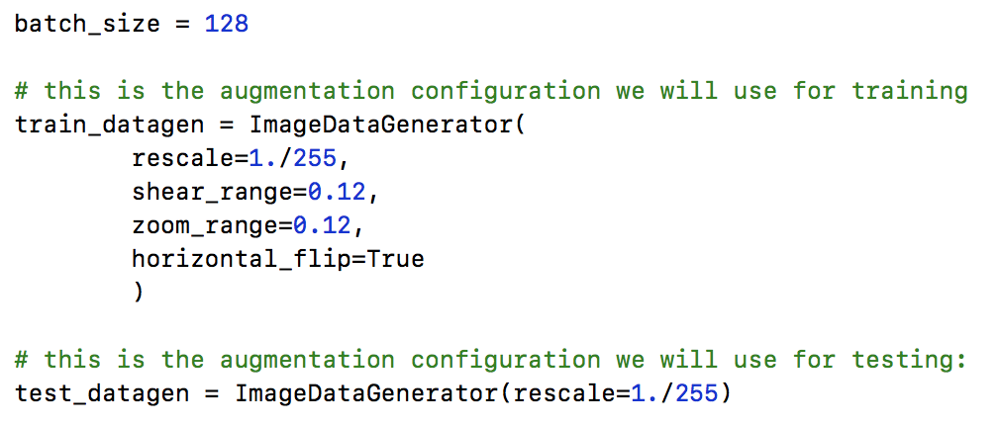
2. Data splitting
Then we set up the generator for training sets and validation sets.
(Type or copy the generator from sample_model.py)

Slide 13
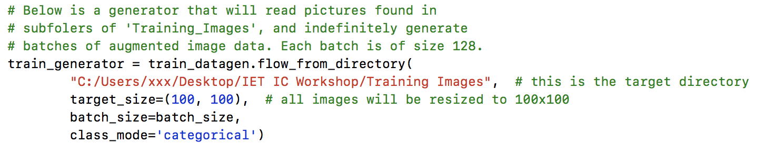
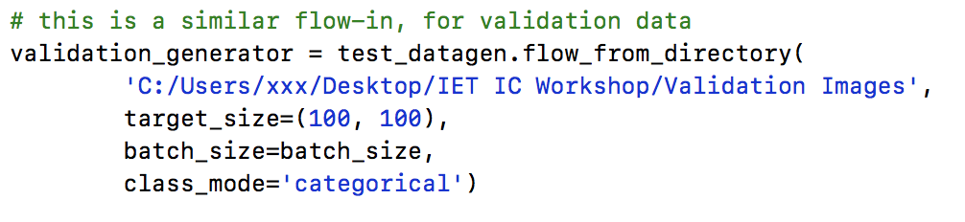
The training and validation images are ready to flow in the program!
(Type or copy the code from sample_model.py)

Slide 14
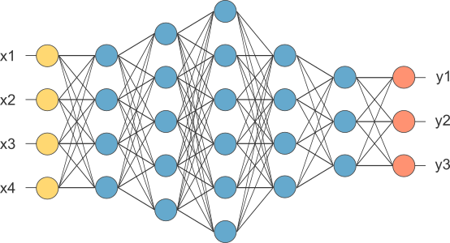
3. Model Built-up
Neural Networks Models are basically
the combination of different Math Manipulations & Activation Functions.
Data flow in
Predication Output
Activiation functions
Hidden Layers (Intermediate Results) (in Blue)

Slide 15
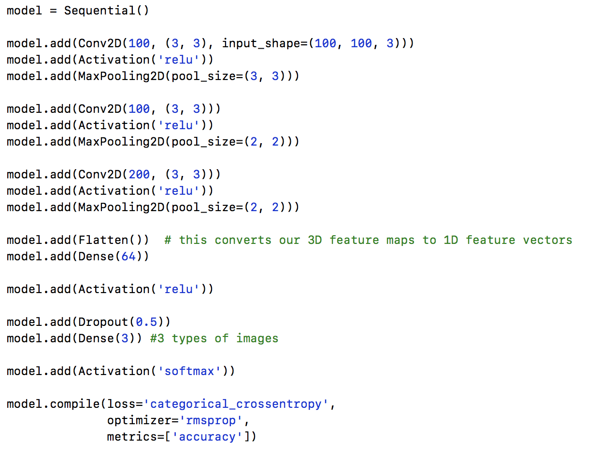
Here we implement a naïve neural network by hand.
This is the whole view
of the neural network.
Details of each part will be explained in the following slides.

Slide 16
Model box: Sequential()
Sequential():
The function Sequential() is providing an “empty box” for the further implementation.
In other words, it is used to initialize the neural network model so that later we can add layers to this model.

Slide 17
Here we implement a naïve neural network by hand.
Simple Analogy of
Neural Network Layers
(For our model,
there is only 2 hidden layer)

Slide 18
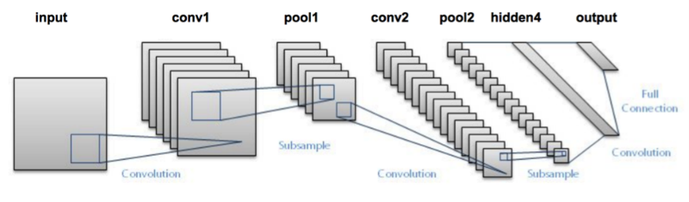
Convolutional layer
Feature extractor: Conv2D
Conv2D:
The convolution is usually the first step of a Convolutional Neural Network (CNN) on the training images. Each of the convolutions can be imagined as a flashlight that is shedding light upon and sliding over the image.

Slide 19
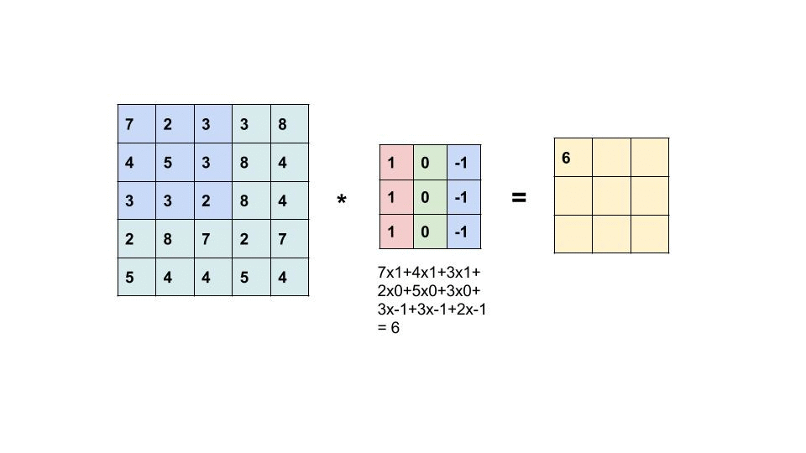
How Conv2D works: element-wise computation

Slide 20
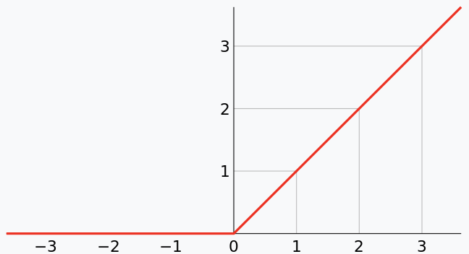
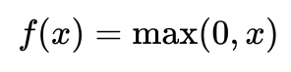
Activation function: ReLU
ReLU:
Rectified Linear Unit (ReLU) is a kind of widely-used activation functions in CNN.
It finds wide applications in the area of Computer Vision and Speech Recognition.
“f(X) = X for any non-negative X”

Slide 21
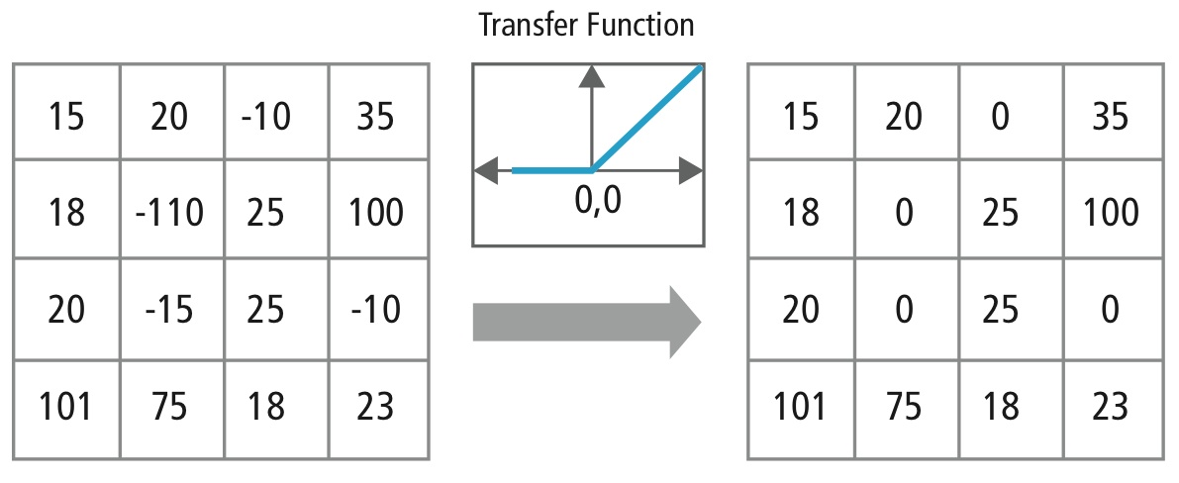
How ReLU works: element-wise positive

Slide 22
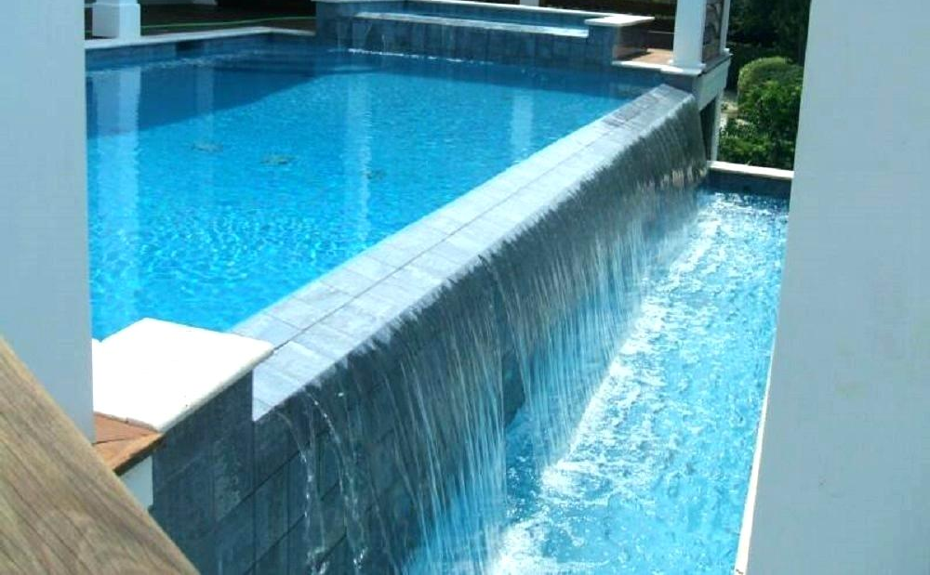
Down-sampling: Maxpooling2D
MaxPooling2D:
MaxPooling2D is used for pooling operation. Pooling is mostly used immediately after the convolution to reduce the overwhelming data size (only width and height).
This reduces the number of parameters, hence reducing the computation and increasing efficiency.

Slide 23
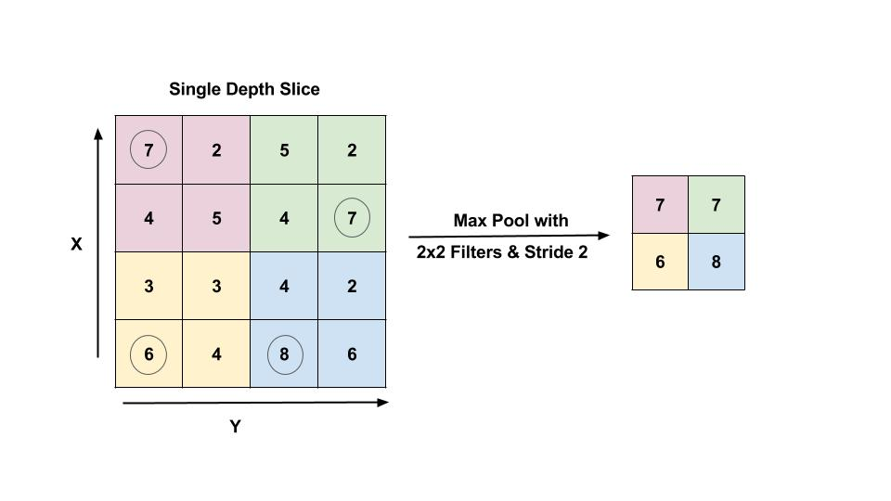
How MaxPooling2D works: region-wise max

Slide 24
Fully connected network: Flatten and Dense Layer
Flatten: Flattening is the process of converting all 3-D arrays into a single long continuous linear vector.
Dense: We also import Dense to perform the full connection of the neural network. A dense layer is a regular layer of neurons in a neural network. Each neuron receives input from all the neurons in the previous layer, thus densely connected.

Slide 25
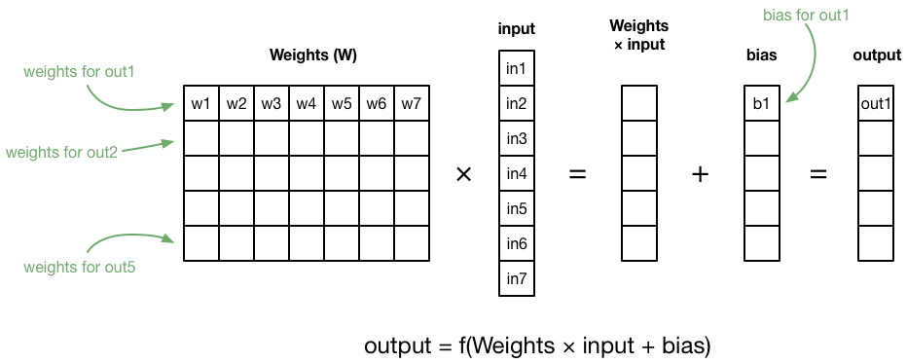
How Dense() works: y=Wx+b

Slide 26
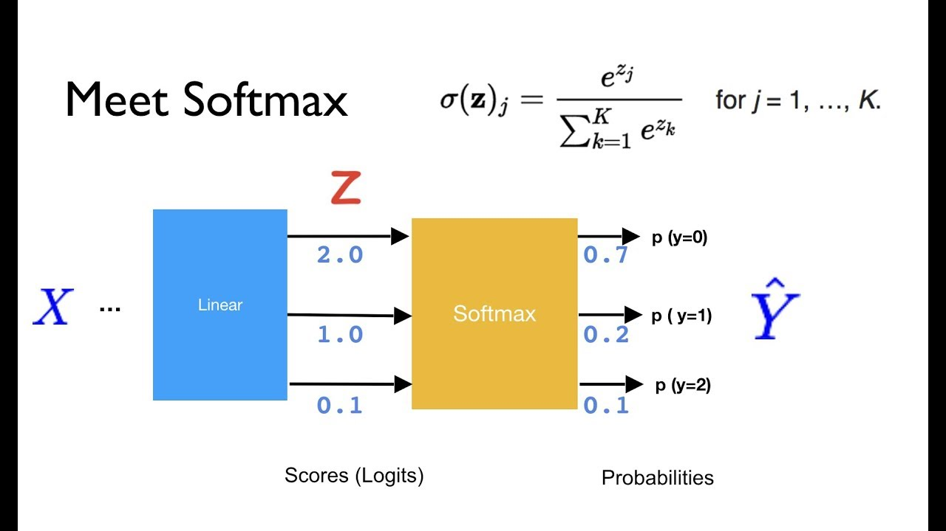
Map to probability: softmax()

Slide 27
Model training
Model training: compile()
Lastly, the model.compile gather up all the settings above and packed up the model for further training.

Slide 28
Loss: cost function
loss:
The function is to represent the difference between the actual output and the predicted output by machine. During our training of the model, we will attempt to minimize the value. binary_crossentropy is usually used for a binary problem.

Slide 29
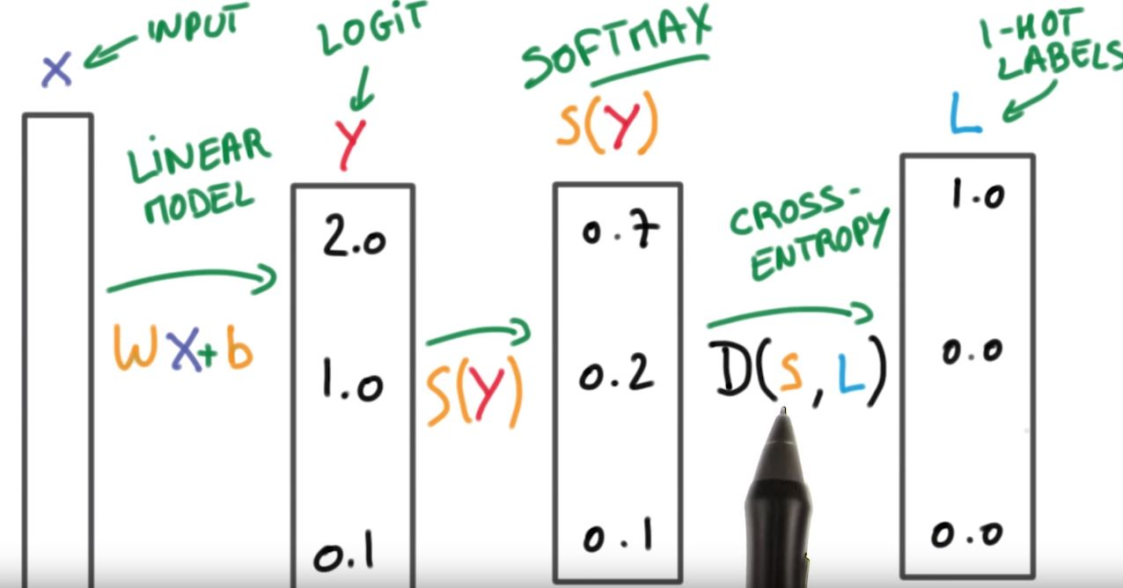
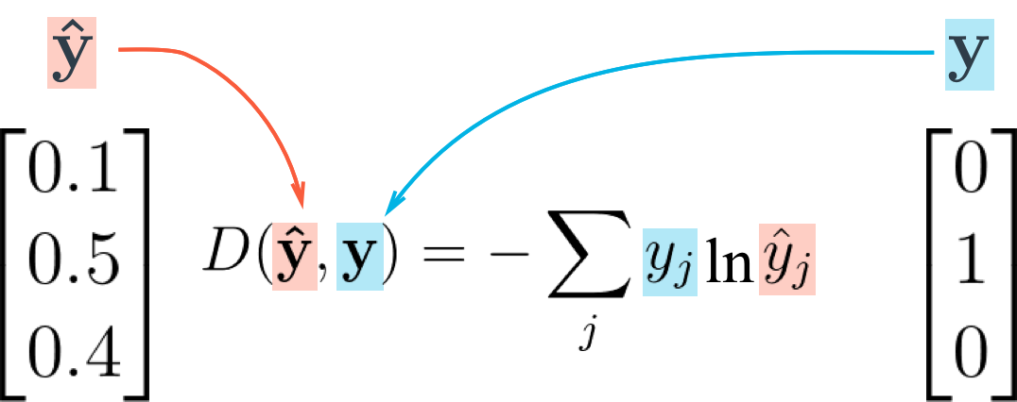
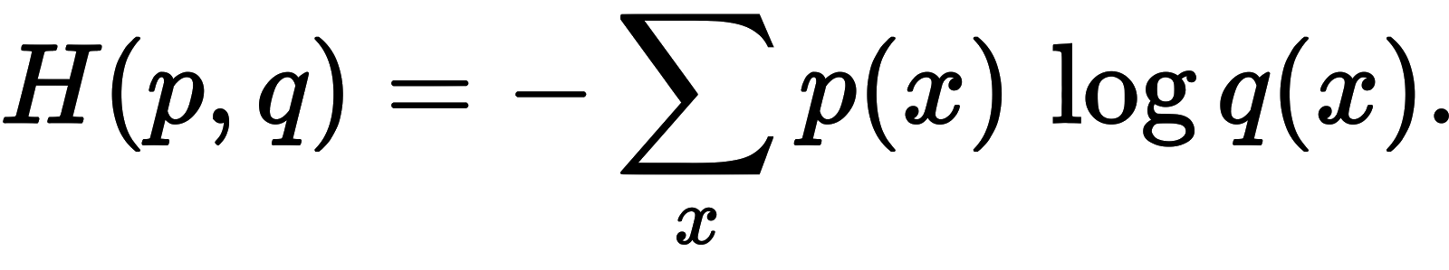
How cost function works:

Slide 30
Optimization
Optimizer: stochastic gradient descent (SGD)
optimizer: The function is to update the internal parameters of a model in such a way that the loss function is minimized.
metrics: List of data. Accuracy means the percentage of correct answers. Metric values are recorded at the end of each epoch on the training dataset. It represents how well the model works just like the GPA.

Slide 31

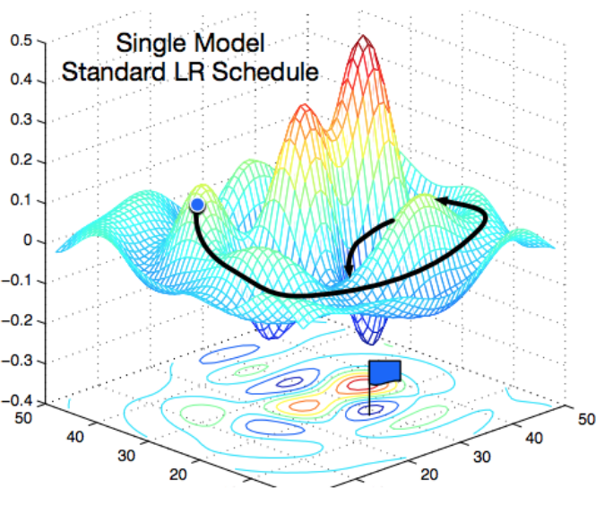
How SGD works: finding minimum point by negative gradient

Slide 32
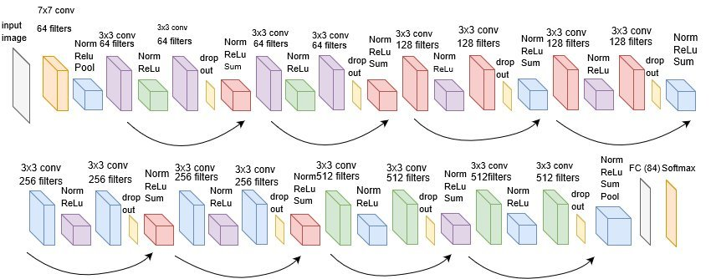
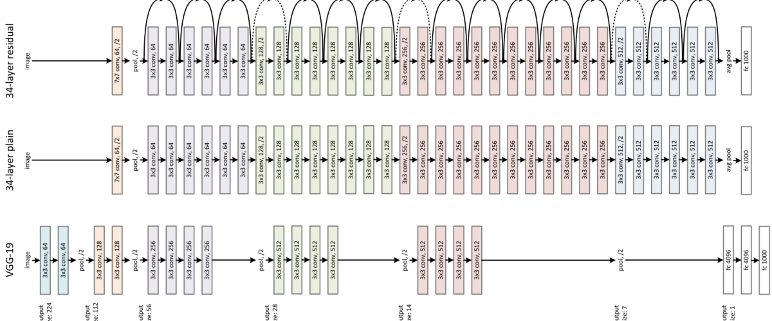
Pretrained models
Best tool: github
Up to now, we have briefly explained how the functions in the model works.
If you cannot memorize all the terms, don’t worry. Many engineers just use pre-implemented models proposed by CS research institutions (e.g. CMU, UC Berkeley, Tsinghua, NTU, NUS)

Slide 33
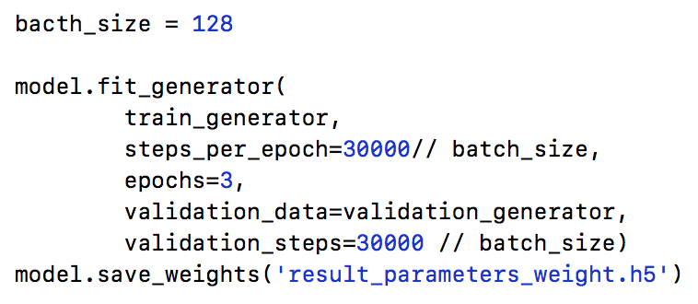
Model training & validation
Last step: set the configuration to save the trained parameter of your model
validation data:
The data generator we have created previously for validation image data.
generator:
The data generator we have created previously for training image data.
epochs:
For each single epoch, the neural network is trained on every training samples to update its parameters.

Slide 34
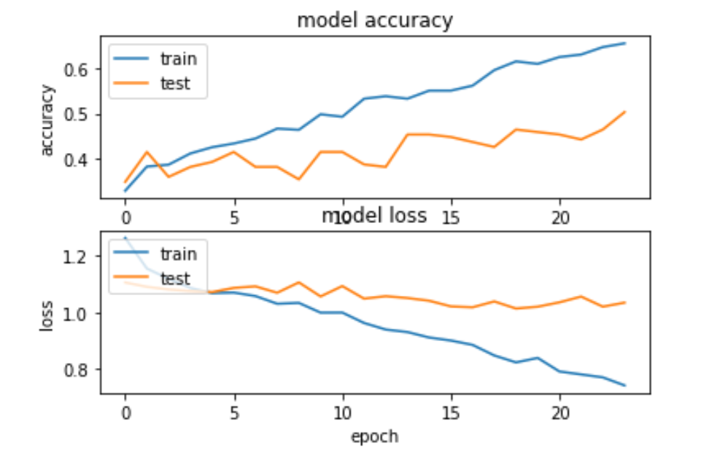
Model Built-up & Model Training
Run the whole file and wait until it terminates.
This may take a few minutes. Please inform the assistants if any bugs happen.

Slide 35
Make predictions with the Model
Now you have a result.h5 file which stores the parameter that you calculated.
You can begin using this result to classify Baby Hats, Pants & Shirts images.
Do remember to put your own pictures of jpg format in the your-own- images folder and edit the predict_with_trained_parameters.py with your own file path.
Run this py file to see the classification result of your images.

Slide 36
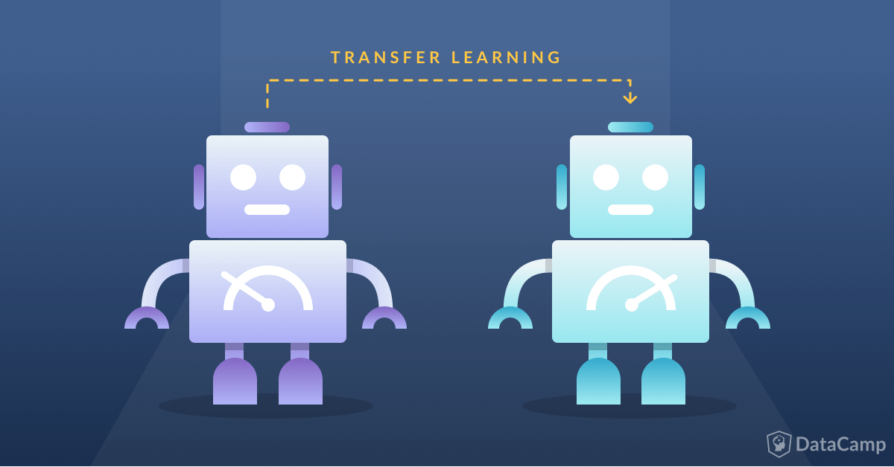

Open ISSUE IN AI
How to deal with insufficient data?
Transfer learning
How to design a deep model?
Model search (AutoML by Google)
How to accelerate the computation?
Pruning / Quantization / Distillation
How to understand a deep model?
Healthcare
Fintech

Slide 37
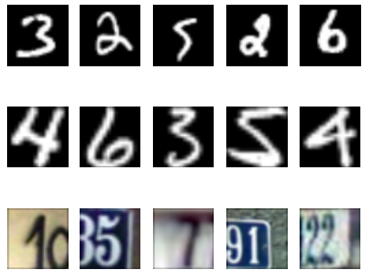
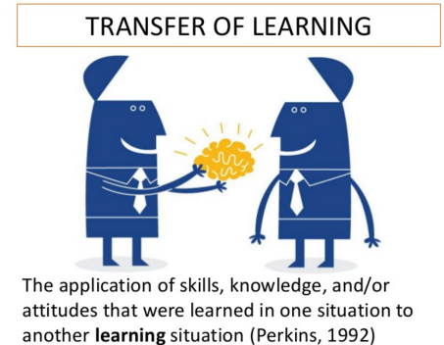
TRANSFER LEARNING
Using limited labeled data and large scale of unlabeled data to train a reliable network.
Example: digit recognition
MNIST data: handwritten digits
SVHN data: Google view

Slide 38
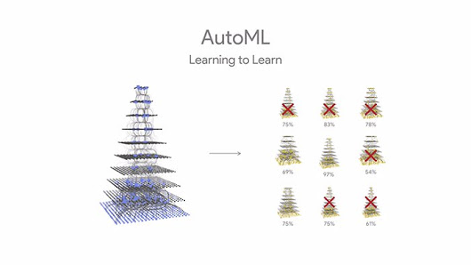
Auto ml

Slide 39
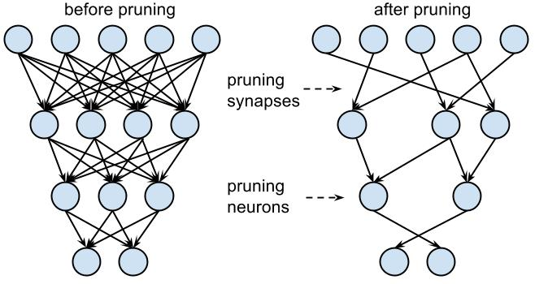
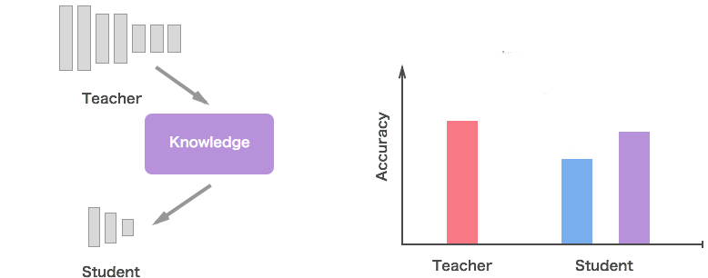
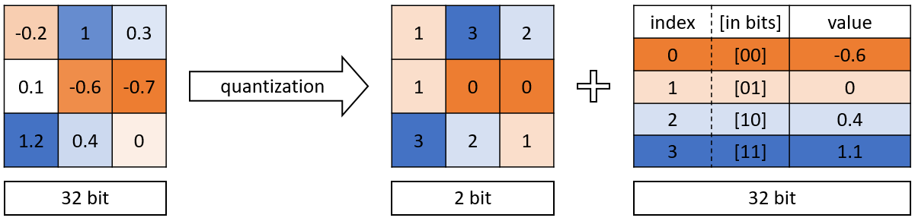
acceleration
Pruning
Distillation
Quantization

Slide 40
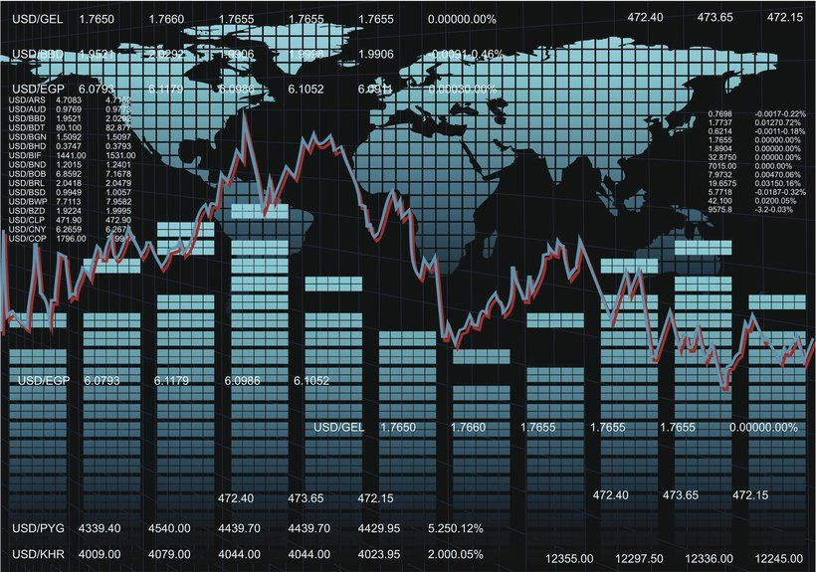

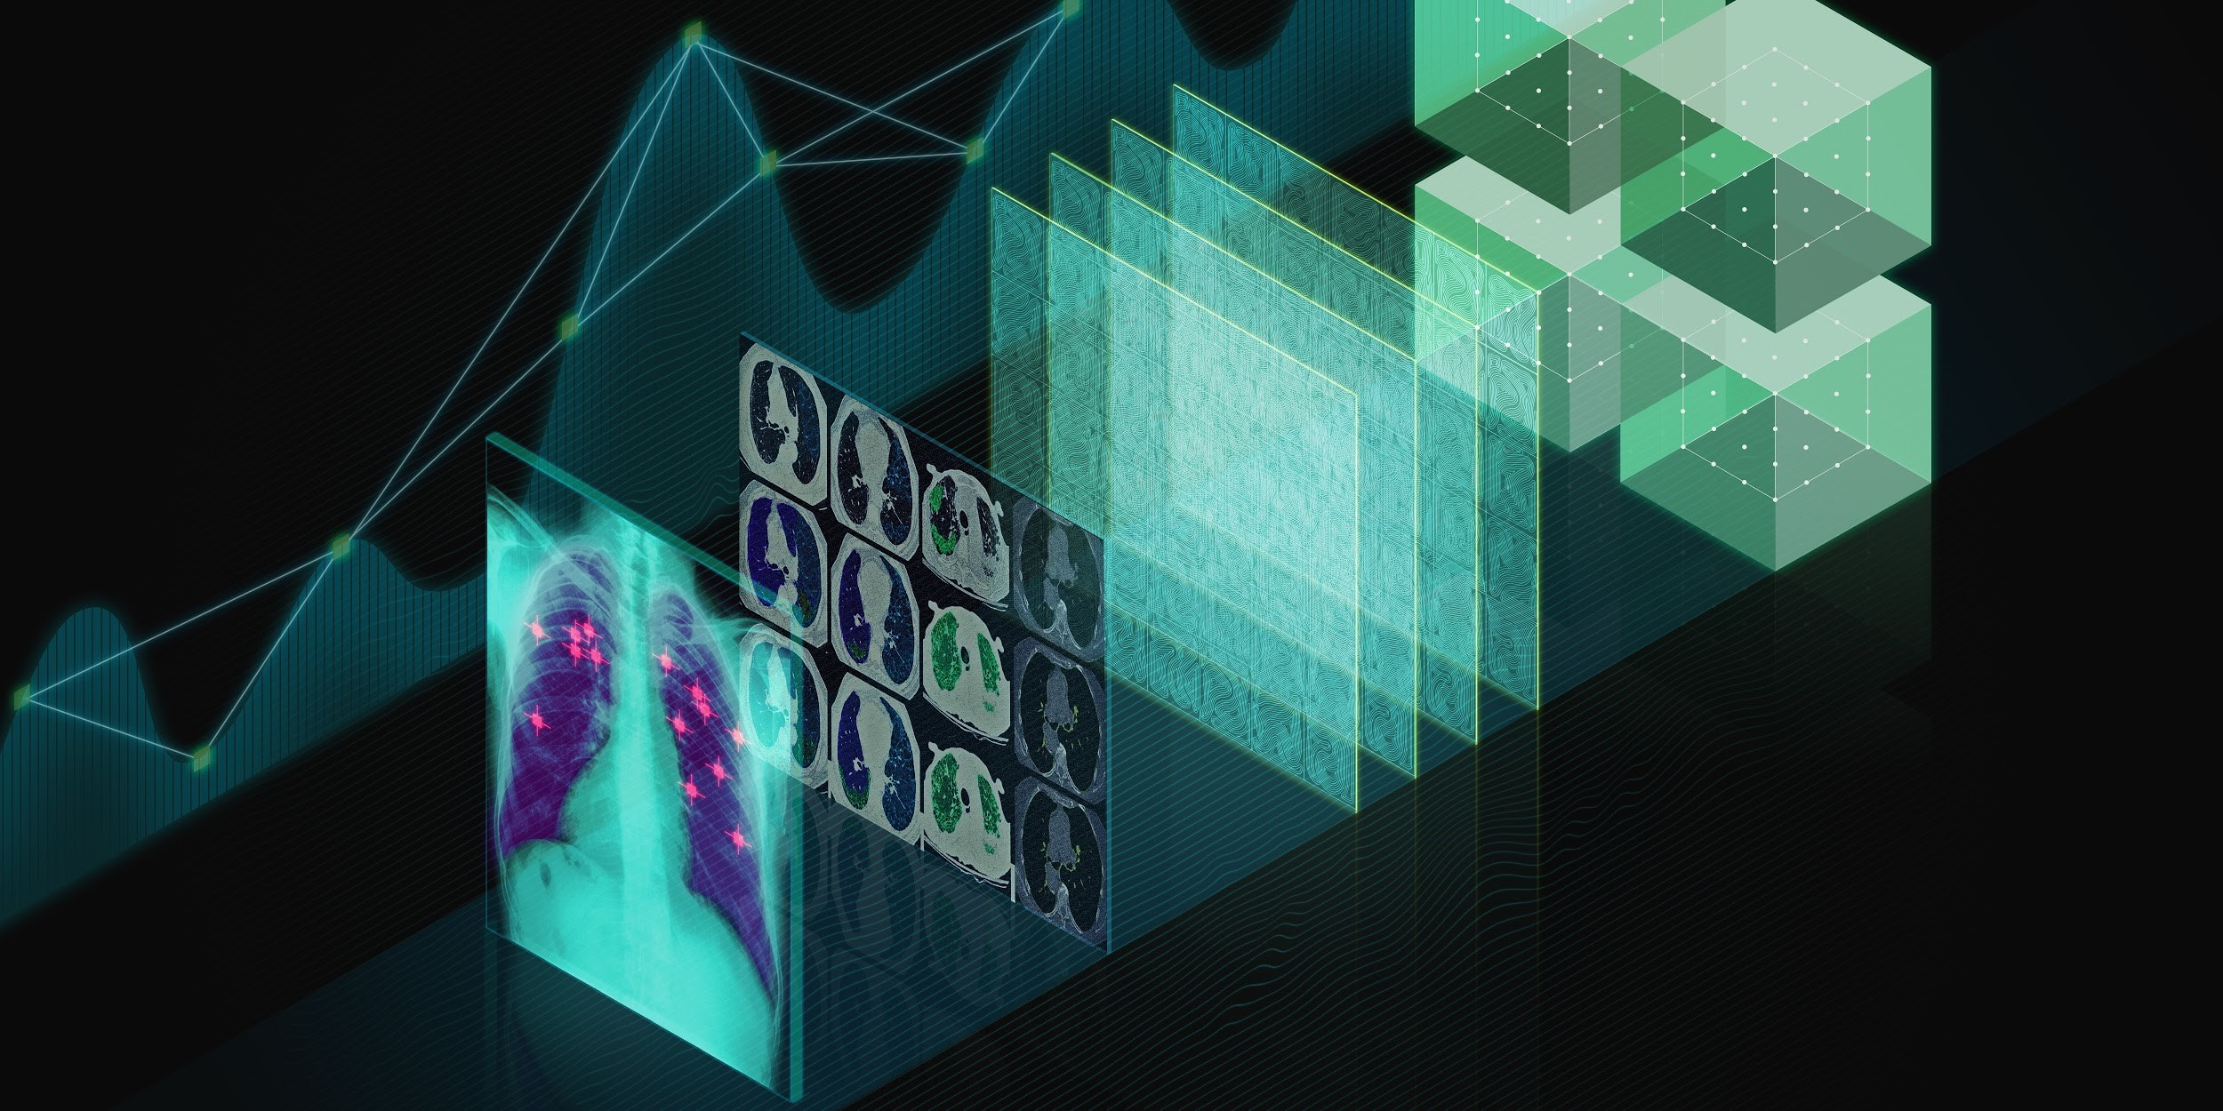

AI understanding

Slide 41
THANK YOU! Q & A

